Slide 1
Logistics data analysis Using R programming
Monitoring outbound volume against capacity
Final term project
Taewon Kim(91221629)
2021.12.05

Slide 2

Project plan
Background:
Outbound capacity plan for fulfillment centers is important to allocate total orders
It seems outbound volume is getting increased
Adjusted capacity needs to be applied reflecting the current trend
Purpose:
Monitoring outbound volume against capacity
Forecasting next month’s demand

Slide 3
Creating data I
Date format setup:
year <- 2021
month <- 10
day <- 1:31
Date <- as.Date(ISOdate(year, month, day))
Date
Data variables for each fulfillment center
FC1 <- data.frame(c(1:31),Date, rep("FC1", 31), rnorm(31,0.01*30000,1000), rnorm(31,0.03*30000,1000),rnorm(31,0.01*30000),rnorm(31,0.05*30000),rnorm(31,0.04*30000),rnorm(31,0.05*30000),rnorm(31,0.04*30000),rnorm(31,0.05*30000),rnorm(31,0.05*30000),rnorm(31,0.05*30000),rnorm(31,0.05*30000),rnorm(31,0.05*30000),rnorm(31,0.05*30000),rnorm(31,0.06*30000),rnorm(31,0.08*30000),rnorm(31,0.07*30000),rnorm(31,0.07*30000),rnorm(31,0.07*30000),rnorm(31,0.05*30000),rnorm(31,0.02*30000),rnorm(31,0.01*30000),rnorm(31,0.01*30000,500),rnorm(31,0.01*30000,500),rnorm(31,0*30000,0) )
names(FC1) <- c("Seq", "Date","FC_Name", "06","07","08","09","10","11","12","13","14","15","16","17","18","19","20","21","22","23","24","01","02","03","04","05")
※ Make data with the same query for FC2 and FC3

Slide 4

Data description
Mean and Standard deviation by FC
tapply(All_FC_Data$Daily_order, All_FC_Data$FC_Name, mean)
tapply(All_FC_Data$Daily_order, All_FC_Data$FC_Name, sd)
Mark FC which order volume is more than capacity based on daily basis
All_FC_Data$Diff_Capacity <- All_FC_Data$Capacity - All_FC_Data$Daily_order
All_FC_Data$Beyond_Capacity <- ifelse(All_FC_Data$Diff_Capacity > 0, 0, 1)
tapply(All_FC_Data$Beyond_Capacity, All_FC_Data$FC_Name, sum)
FC1, FC2 and FC3 has 11, 11, 14 times respectively when they have more orders than their capacities.
Result
Result

Slide 5
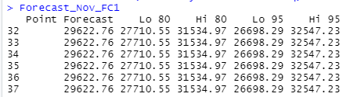
Order forecast I
By using “forecast()”: using average
library(forecast)
FC1$Daily_Order <- rowSums(FC1[,c(4:27)],na.rm=TRUE)
Forecast_Nov_FC1 <- forecast(FC1$Daily_Order, h=30)
FC2$Daily_Order <- rowSums(FC2[,c(4:27)],na.rm=TRUE)
Forecast_Nov_FC2 <- forecast(FC2$Daily_Order, h=30)
FC3$Daily_Order <- rowSums(FC3[,c(4:27)],na.rm=TRUE)
Forecast_Nov_FC3 <- forecast(FC3$Daily_Order, h=30)
The same forecast Qty. has been applied for the whole month
Result

Slide 6
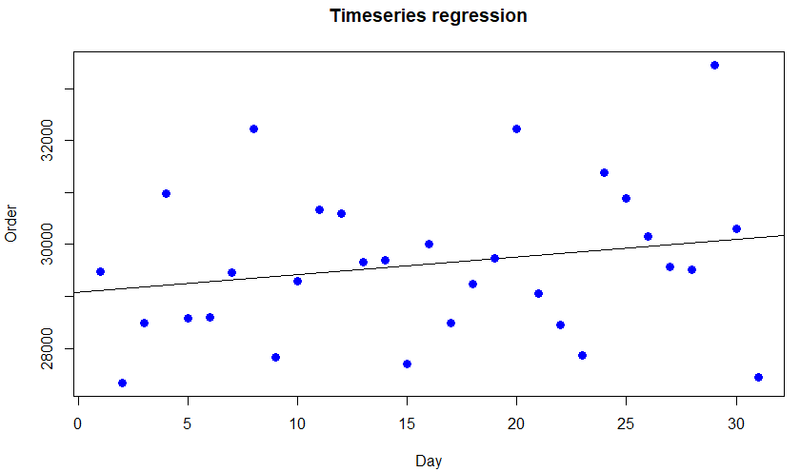
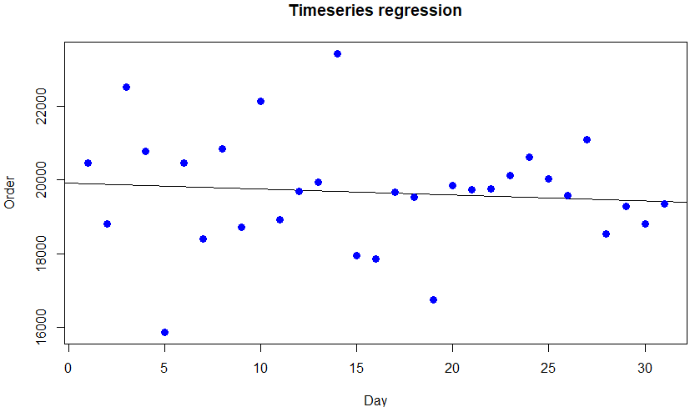
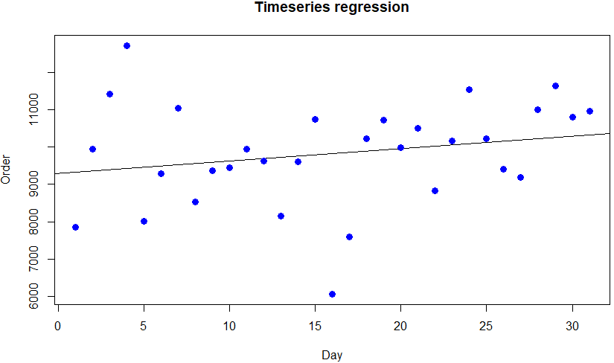
Order forecast II
By using “lm()”: using regression
relation_FC1 <- lm(FC1$Daily_order ~ FC1$Seq)
print(relation_FC1)
summary(relation_FC1)
plot(FC1$Seq,FC1$Daily_order, col = "blue", main = "Timeseries regression",
abline(lm(FC1$Daily_order ~ FC1$Seq)), cex =1.3, pch =16, xlab="Day", ylab="Order")
relation_FC2 <- lm(FC2$Daily_order ~ FC2$Seq)
print(relation_FC2)
summary(relation_FC2)
plot(FC2$Seq,FC2$Daily_order, col = "blue", main = "Timeseries regression",
abline(lm(FC2$Daily_order ~ FC2$Seq)), cex =1.3, pch =16, xlab="Day", ylab="Order")
relation_FC3 <- lm(FC3$Daily_order ~ FC1$Seq)
print(relation_FC3)
summary(relation_FC3)
plot(FC3$Seq,FC3$Daily_order, col = "blue", main = "Timeseries regression",
abline(lm(FC3$Daily_order ~ FC3$Seq)), cex =1.3, pch =16, xlab="Day", ylab="Order")
Result

Slide 7

Conclusion
In order to use Lear regression model for this case,
Adjusted R square and P-value should be within the proper range. In this case, Every Adjusted R square for three FCs are less than 0.1 which is very low which indicate the inferred model is not explainable for the real situation. Besides, P-value is much more than 0.05 which also makes the model not trustworthy.
Due to the high fluctuation in daily order in each fulfillment center, capacity management is very difficult. In order to reduce the order fluctuation in each fulfillment center, combining fulfillment centers into 1 or 2 seems required.

